Slide 1
Influence of Movie Subscription Service on Box-Office Revenues of Films with Critics’ Negative versus Positive Reviews; A regression Discontinuity Approach
Hari Ravella

Slide 2
introduction
Can a movie subscription service (MOVIE PASS) influence BO performance?
If so, would it be more in case of movies with Critics’ positive reviews or negative reviews?
Can Movie Pass become a disrupter like Red Box or Netflix?
Studies indicate that critics’ reviews reviews are predictors of Box-Office (BO) performance NOT influencers.

Slide 3
MoviePass
Founded in 2011, is an American subscription-based movie ticketing service allowing subscribers to watch movies for a flat monthly subscription fee.
The service went through several pricing structures before launching the plan in August 2017 with single movie per day priced at $9.95 per month. The pricing further dropped to $7.95 in February 2018 for new customers, if they paid annually.
The change in pricing structure in 2017 led to a customer base of over 2 million in six short months since August 2017.
The vision of MoviePass is to make moviegoing experience more affordable.
An independent report by Mather Economics (2016) found that MoviePass members showed 100% increase in moviegoing.

Slide 4
Motion Picture association of America Statistics
2016 global box office receipts were $38.6 billion, an increase of one percent from the previous year.
More frequent moviegoers tend to be in the 18 – 24 years age group and 70% of them own at least four key technology products such as smartphones and tablets.
To buy movie tickets at the majority of the theaters, MoviePass subscribers need to be near (within 100 yards distance) the theaters and will have to use MoviePass Application on their smart devices.
This population of frequent moviegoers also have access to various crtics’ reviews available online.

Slide 5
Research questions
How much influence MoviePass has on Box Office revenues of films?
Variability of the influence of MoviePass for films with critics’ positive, neutral and negative reviews.

Slide 6
Regression Discontinuity design Approach
Regression discontinuity between period before the surge in MoviePass subscribers and after the surge.
Use one of the following design selections to measure the influence of MoviePass on BO performance
Regress 8/2016 – 12/2016 as before period and 8/2017 – 12/2017 as after period for the same group of theaters
Regress the data between the theaters that accept MoviePass versus that don’t accept since the surge in subscription (8/2017 – 12/2017)
Regress 1/2017 – 7/2017 as before period and 8/2017 – 12/2017 as after period for the same theater

Slide 7
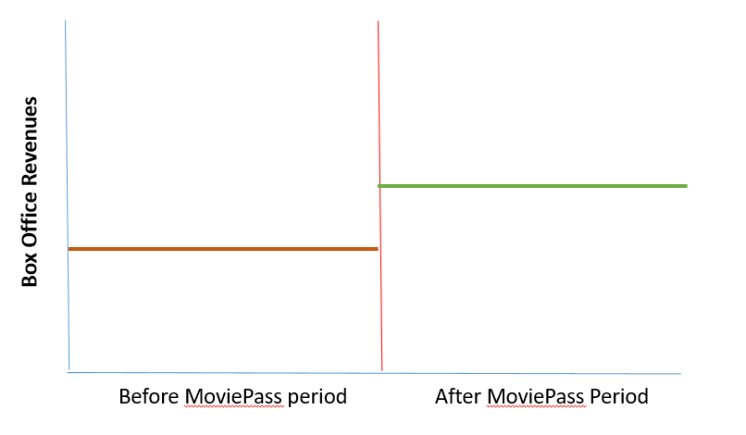
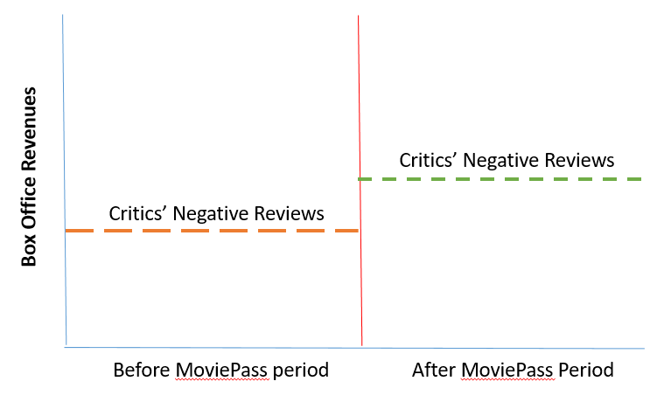
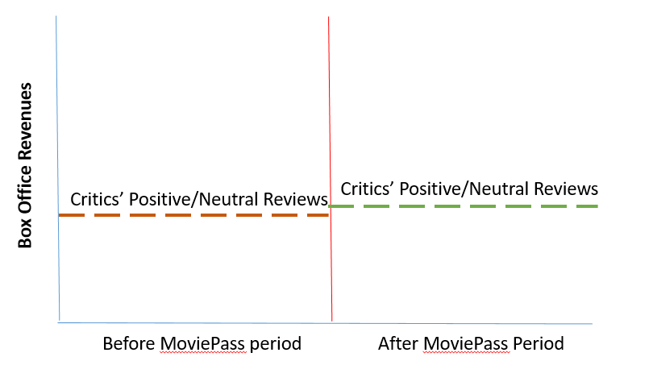
Expected results

Slide 8
implications
MoviePass’ business model is based on
Receives a cut from the distributors/theaters for each movie ticket
receives a percentage of proceeds from the concessions sales.
Additionally, MoviePass has signed up with film studios to promote the films in their app on smart devices. MoviePass does not charge the film studios for the advertisements but gets paid by the film studios for actual customer conversion from the advertisement
MoviePass reported 18% customer conversion from their advertisement of the movies in their apps.
Since critics’ reviews were primarily predictors and not influencers of the movie performance at box office, it is imperative that the film studios of the movies with criticis’ negative reviews take measures to have their films promoted by MoviePass to increase their box office revenues.

